Slide 1
Sexual Health: Everything You Wanted to Know But Were Afraid to Ask
Allison Heath
Kristina Kerchner
Jackie Sanders

Slide 2
What Makes a Relationship Healthy?

Slide 3
Four Keys to a Healthy Relationship
Trust
Respect
Honesty
Communication
This goes for non-romantic relationships too!
Notes:
Trust – the others in your relationship as well as for yourself
Respect – for yourself and for others
Honesty – You and your partner or friends should be honest with one another
Communication – is key for a relationship to work!

Slide 4
Talking about Communication
If you are in a romantic relationship, have you talked to your partner about:
- Having sex
- Using contraception
- Likes and dislikes
- When, where, how….etc.

Slide 5
Condoms, Dental Dams, & More!
Types of contraception you might want to think about:
- Hormonal birth control (pill, patch, injection, ring, or intrauterine )
Condoms – Male or Female, latex or non-latex
Dental Dams
Diaphragm or cervical cap

Slide 6
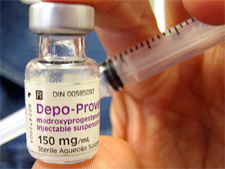
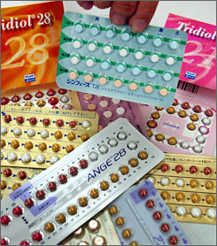
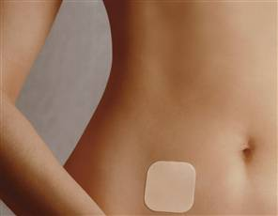
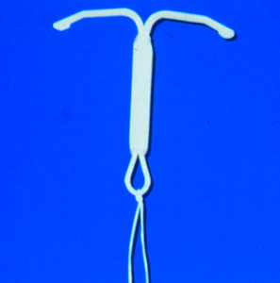
Hormonal Birth Control
These types of contraception protect against pregnancy only. Speak to your doctor to find a method that works best for you!
Notes:
Each type is different – types and amounts of hormones released are different for each. Talking to your GYN or doctor is important to find a method that works well for you. There are side effects and women with latex sensitivity should probably stay away from the patch.

Slide 7
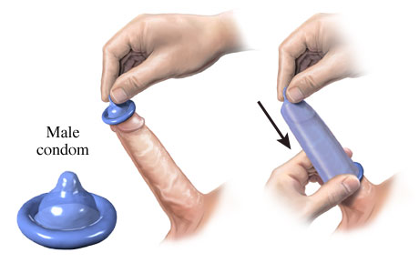
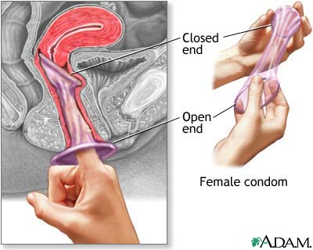
Condoms
Things to think about when using condoms:
- Make sure you are putting it on correctly
- Type that works best for you and your partner
- Protection against pregnancy & STIs
Notes:
Think about comfort, allergies, and the types that work best for you.

Slide 8
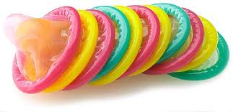
12 Steps for Correctly Using a Male Condom
Get Consent
Check Expiration Date
Check Packaging
Tear Open Carefully
Add a Drop of Lube Inside the Tip
Pinch Tip
Roll Down to the Base of the Penis or Object
“Burp” the Condom
Add Lube to the Outside of the Condom
ACTION!!!
Hold Base of Condom while Pulling Out
Remove and Throw Away

Slide 9
Dental Dams
Dental dams are used for oral-vaginal or oral-anal intercourse. They come in different colors and flavors, and they help prevent transmission of STIs. And you can make one out of a male condom!

Slide 10
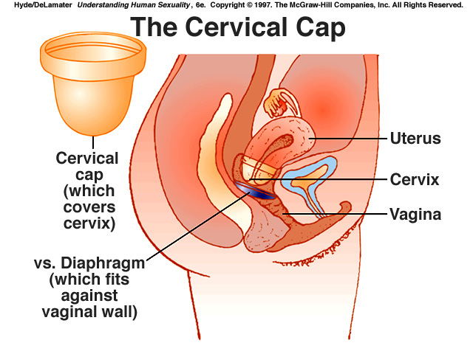
Diaphragm & Cervical Cap
These block sperm from getting past the cervix. They can be used more than once as long as they are cleaned. These only protect against pregnancy.

Slide 11
Why Use Contraception?
Protect against pregnancy
Protect against STIs
These only work if you use the products correctly.

Slide 12
Some More About STIs
Sexually Transmitted Infections
Many have no symptoms
Common symptoms include: discharge, bumps or sores, and burning when you urinate
See a doctor and get tested!

Slide 13
Does Everyone Have an STI?
Of the students surveyed in the 2009 NCHA at NIU the following had been diagnosed or treated by a physician: Chlamydia -1.4%, Genital Herpes – 1.4%, Genital warts/HPV – 4.2%, HIV – 0.2%)

Slide 14
Taking Care of You
Women:
Breast self-exams
Visiting the GYN
Men:
Testicular self-exams

Slide 15
Symptoms of Breast Cancer
The most common symptoms of breast cancer are a change in the look or feel of the breast, a change in the look or feel of the nipple and nipple discharge. These are listed below:
Lump, hard knot or thickening
Swelling, warmth, redness or darkening
Change in the size or shape of the breast
Dimpling or puckering of the skin
Itchy, scaly sore or rash on the nipple
Pulling in of your nipple or other parts of the breast
Nipple discharge that starts suddenly
New pain in one spot that doesn’t go away

Slide 16
Symptoms of Testicular Cancer
Lumps (masses)
Swelling
Pain
These may be symptoms of cancer, or other issues. You should see your doctor if experiencing any of these.

Slide 17
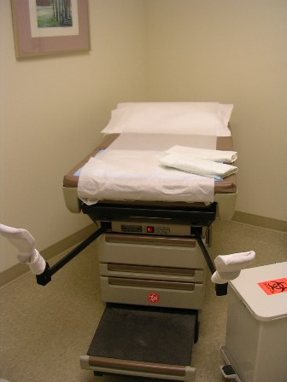
Visiting the GYN
Pelvic examinations and Pap smears
Breast Exam
They may also do STI testing or an HIV Test.
Most importantly about this visit, be open and honest, and ask the doctor about any concerns that you have.

Slide 18
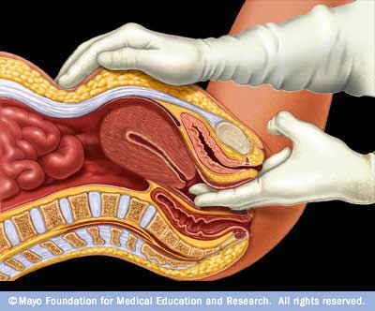
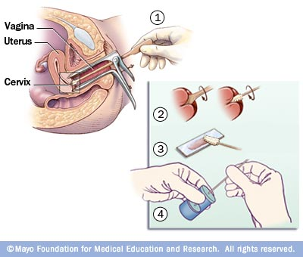
Pelvic examinations and Pap smears
Two main parts of a visit to the GYN

Slide 19
Questions, Comments, Cares, Concerns???

Slide 20
Contact Information
Health Enhancement
Evans Field House Rm. 139
Phone: 815-753-9755
Email: healthenhancement@niu.edu

